Slide 1
Research on 3D Reconstruction Based on Optimized DUSt3R in Civil Infrastructure
Yingxue Zhang
Supervisors: Ling Li Senjian An
14/03/2024

Slide 2
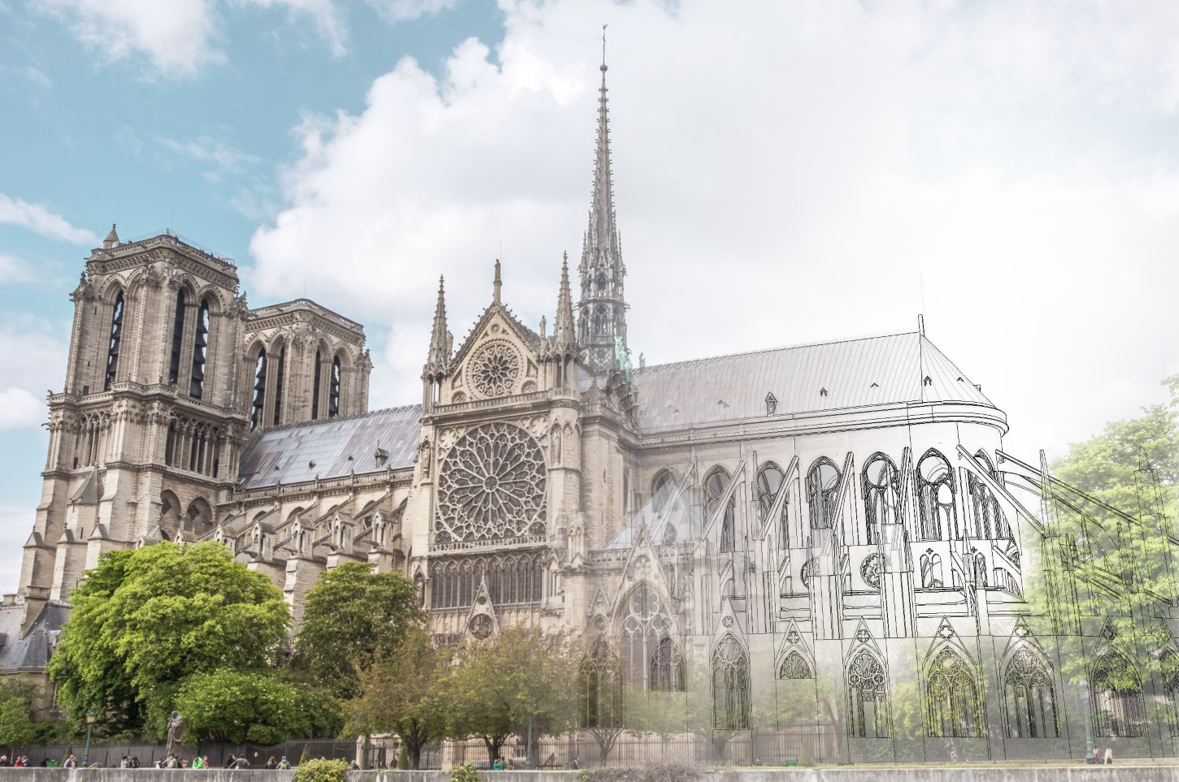
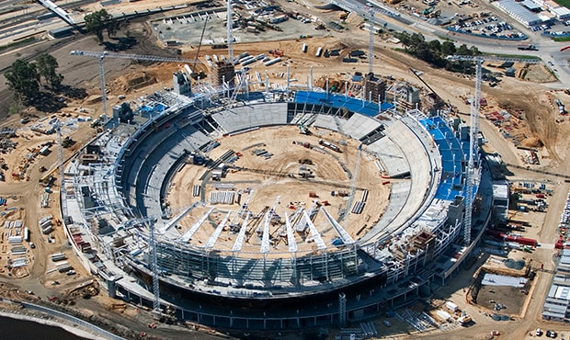
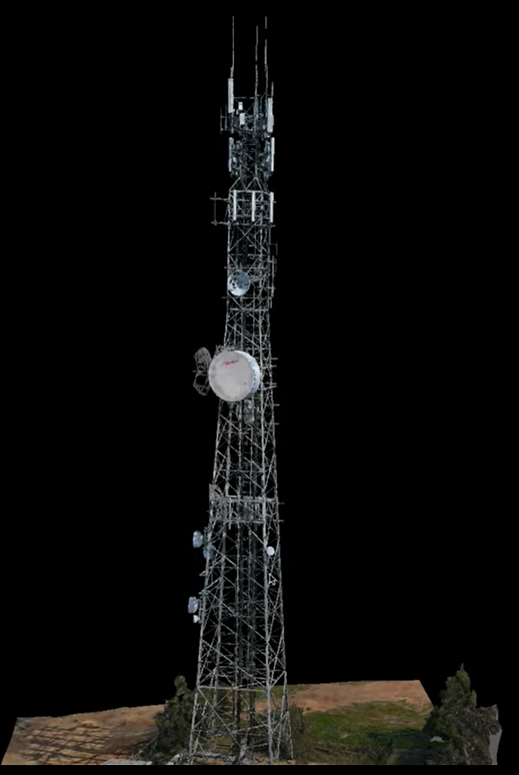
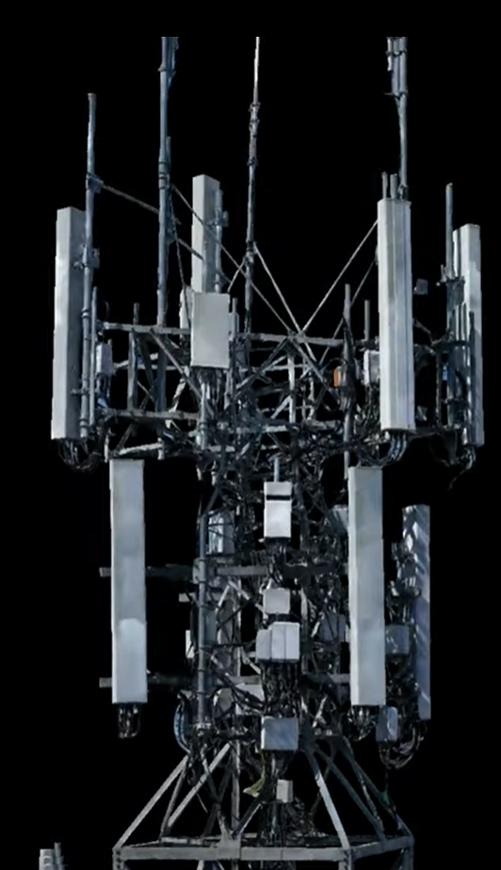
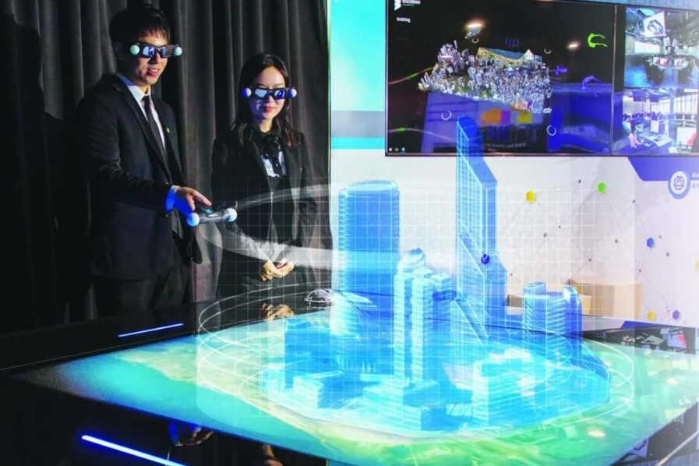
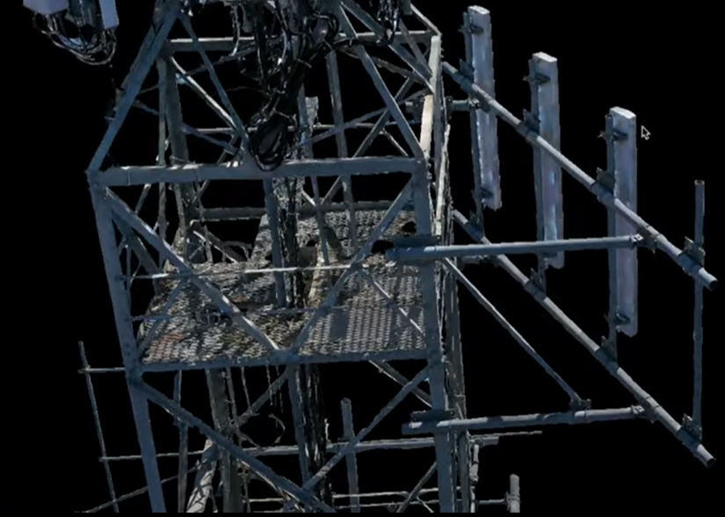
3D Reconstruction in Civil Infrastructure - Importance
Rapidly providing 3D Models (for existing civil infrastructure) can:
Source: https://www.glocomp.com/restoring-notre-dame-de-paris-todays-technology-breathes-new-life-to-a-beloved-landmark/
Source: https://www.afl.com.au/news/155794/new-perth-stadiums-progress-in-pictures
Source: https://www.youtube.com/watch?v=8gCmm6JECXE
Source: https://zhuanlan.zhihu.com/p/455356795
Support renovation design or reconstruction conveniently
Monitor construction progress remotely
Regular inspection in dangerous areas such as high altitudes or underground
Discuss and solve problems intuitively to ensure efficient communication with stakeholders
Notes:
Notre Dame de Paris

Slide 3
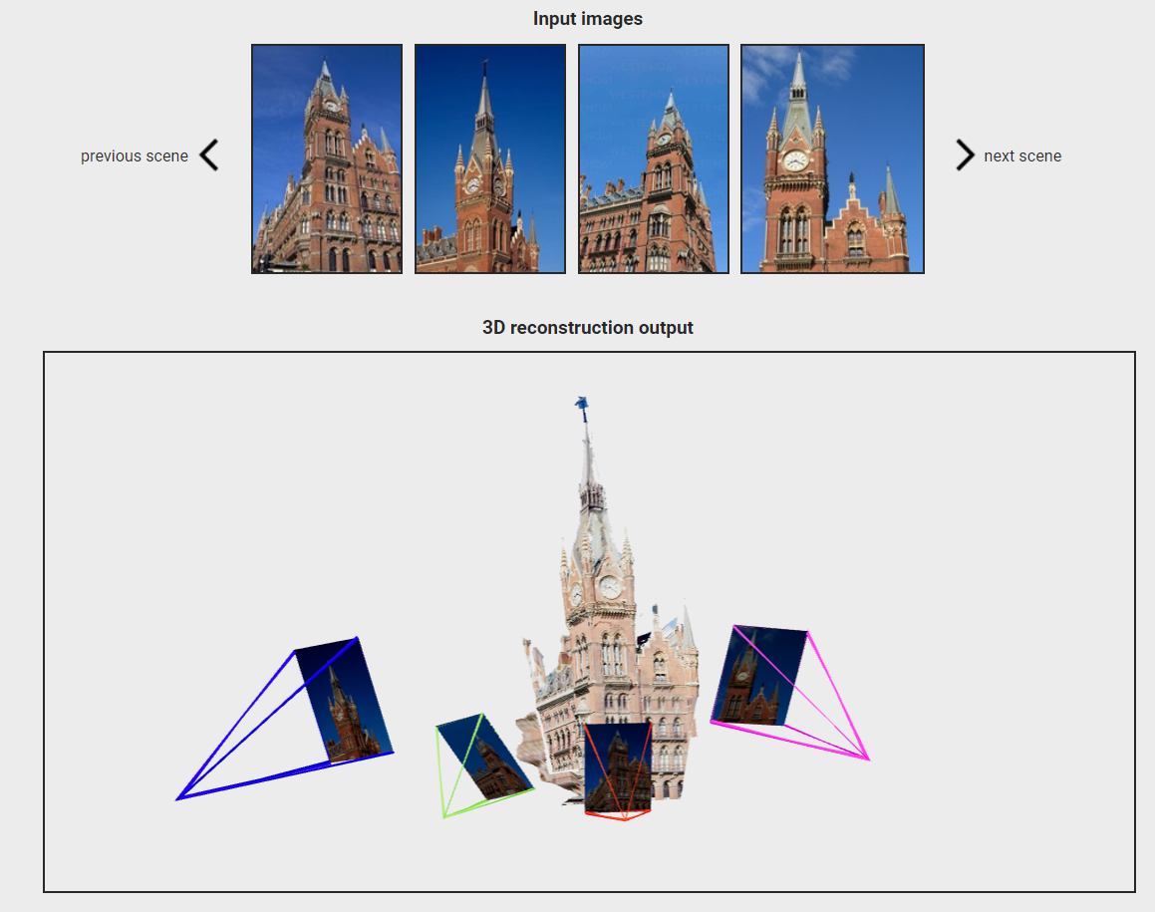

DUSt3R
Estimate the camera parameters
Triangulate corresponding pixels in 3D space (including camera calibration and viewpoint poses)
These two are needed in all Multi-view stereo reconstruction(MVS) algorithms for best performance.
In DUSt3R, none of them are needed.
All it needs: arbitrary image collections
Each method has its drawbacks, so an optimized method for civil infrastructure based on it needs to be proposed.
(Performance, the completeness of 3D model……)

Slide 4
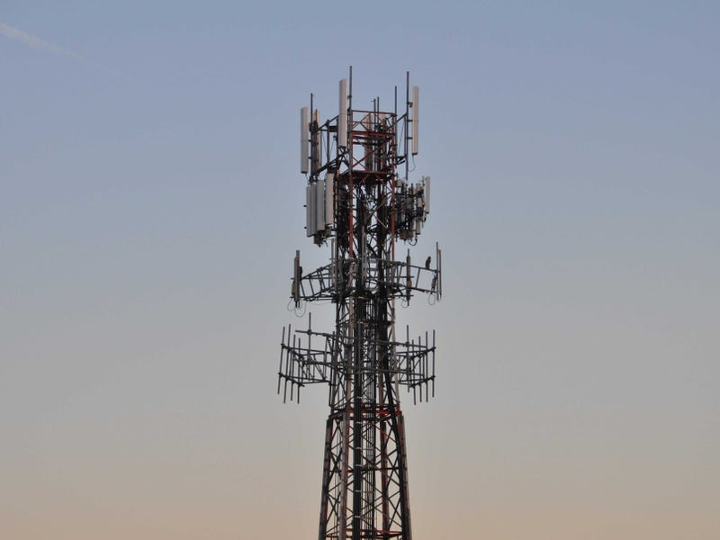
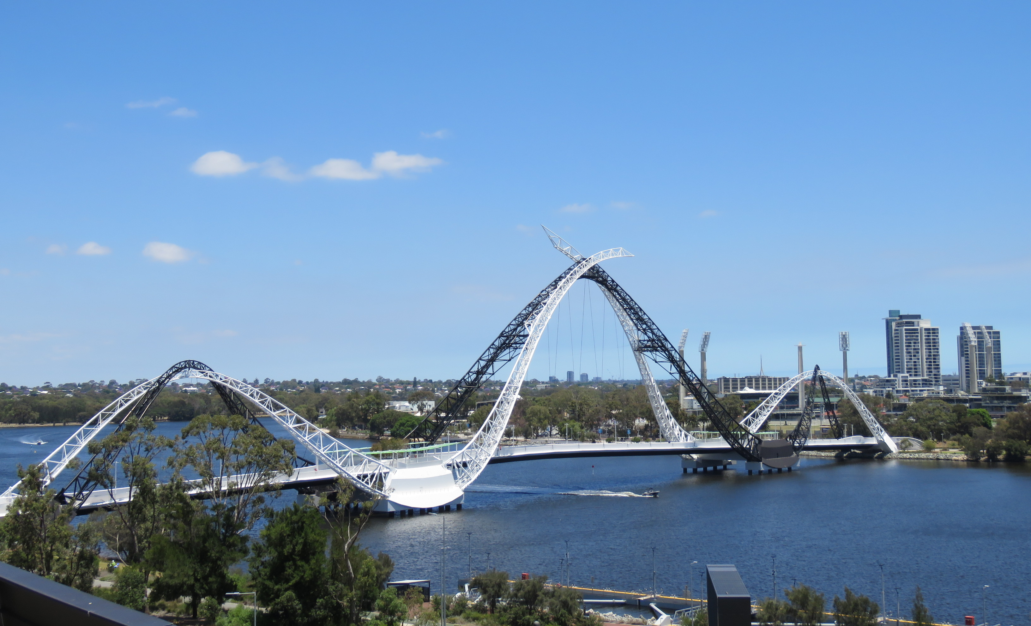
My Research
Topic：
Research on 3D Reconstruction Based on Optimized DUSt3R in Civil Infrastructure
Propose an optimization algorithm based on DUSt3R, then apply it to civil infrastructures.
A wireless tower
Matagarup bridge in Perth
Application of 3D reconstruction in civil construction based on optimized DUSt3R

Slide 5

Research Plan
Term 1: Proposal (with some preliminary results)
Term 2: Implementation
Term 3: Algorithm Optimization (with some new ideas)

Slide 6
Research Plan
Timeline of Term 1
Task/Activity | 2024
 | Mar | Apr | May | Jun | Jul
Literature review and taking notes of core materials
Research question refine
Research proposal writing
Preliminary results collation
Any risk assessment, ethics, approvals etc.

Slide 7






Research Tools

Slide 8
Thanks!

